Slide 1
NEURAL NETWORKS
Laura Hervert Escobar

Slide 2

Neural Networks
Neural networks are a set of algorithms, modeled loosely after the human brain, that are designed to recognize patterns.
They interpret sensory data through a kind of machine perception, labeling or clustering raw input.
The patterns they recognize are numerical, contained in vectors, into which all real-world data, be it images, sound, text or time series, must be translated.

Slide 3
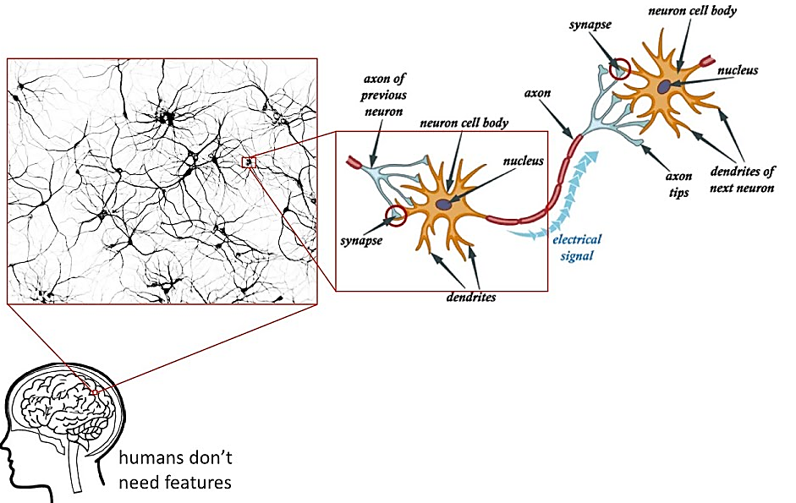
The cell body. The cell body effectively sums and thresholds these incoming signals.
The point of contact between an axon of one cell and a dendrite of another cell is called a synapse.
The axon. The axon is a single long fiber that carries the signal from the cell body out to other neurons.
The dendrites. These are tree-like receptive networks of nerve fibers that carry electrical signals into the cell body
The brain consists of a large number (approximately 1011) of highly connected elements (approximately 104 connections per element) called neurons.

Slide 4
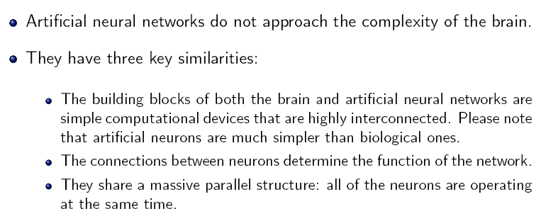
Artificial neural networks

Slide 5
Features of ANNs
CHARACTERISTIC | TRADITIONAL METHODS | ARTIFICIAL NEURAL NETWORKS
Logics | Deductive | Inductive
Processing principle | Logical | Gestalt
Processing style | Sequential | Distributed (Parallel)
Function realised through | Concepts, rules, calculations | Concepts , images, categories maps
Connection between concepts | Programmed a priori | Dynamic, evolving
Programming | Through a limited of rigid rules | Self-programmable (given an appropiate architecture)
Learning | By rules | By examples (analogies)
Self-learning | Through internal algorithmic parameters | Continously adaptable
Tolerance error | Mostly none | Inherent

Slide 6
ANNs – some properties
Learning from examples( labeled or unlabeled )
Adaptivity (changing the connection strengths to learn things)
Non-linearity (the non-linear activation functions are essential)
Fault tolerance (if one of the neurons or connections is damaged, the whole network still works quite well)
Thus, they might be better alternatives than classical solutions for problems characterised by:
high dimensionality, noisy, imprecise or imperfect data; and
a lack of a clearly stated mathematical solution or algorithm

Slide 7
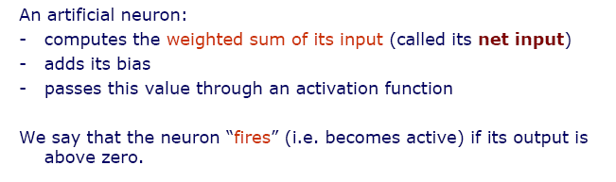
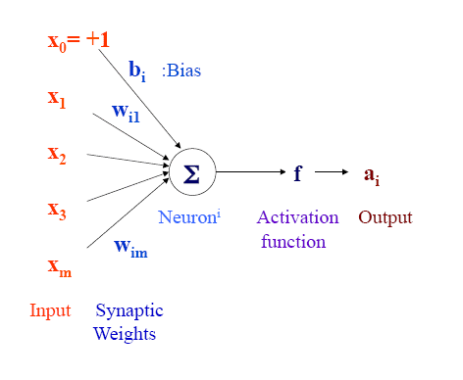
Elements of neuron

Slide 8
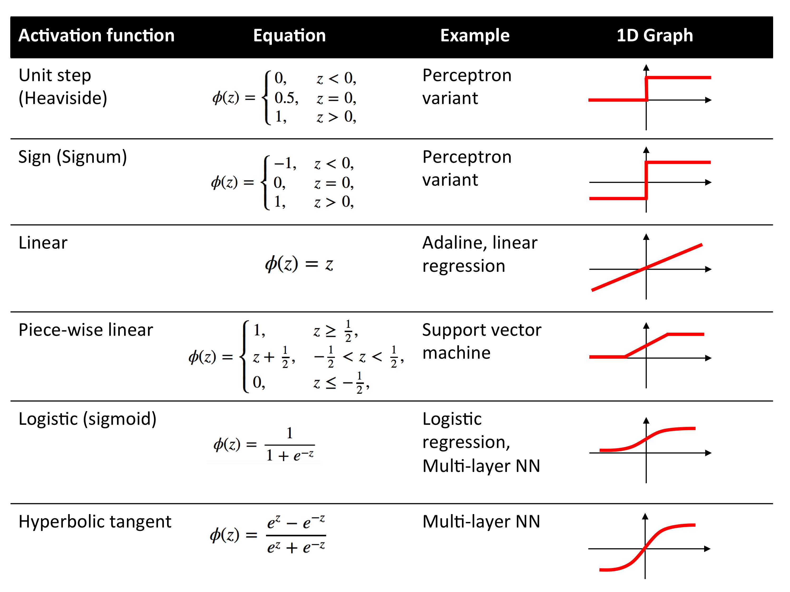
Also called the squashing function as it limits
the amplitude of the output of the neuron.

Slide 9
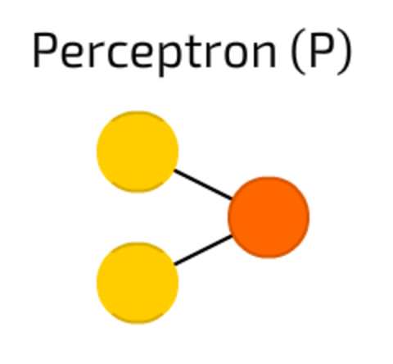

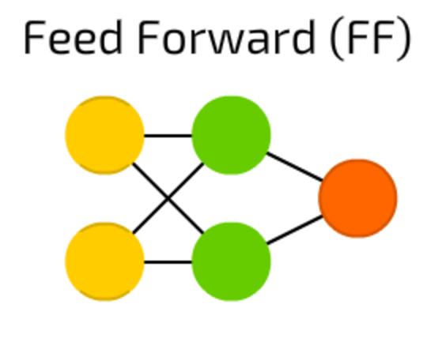
Neural Network topologies (©Fjodor van Veen asimovinstitute.org )
The simplest and oldest model of Neuron, as we know it. Takes some inputs, sums them up, applies activation function and passes them to output layer. No magic here.
all nodes are fully connected
activation flows from input layer to output, without back loops
there is one layer between input and output (hidden layer)
In most cases this type of networks is trained using Backpropagation method.

Slide 10
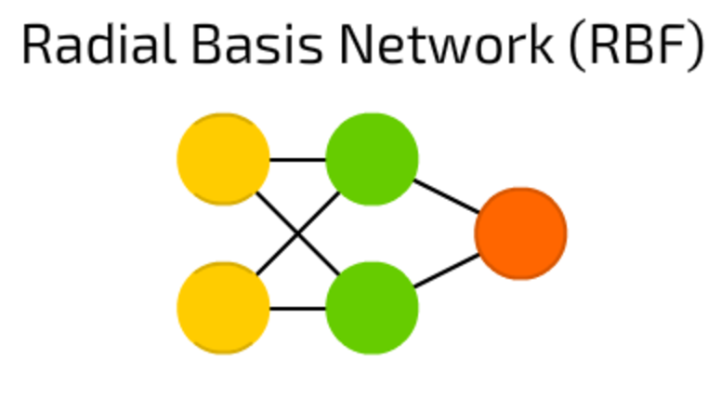
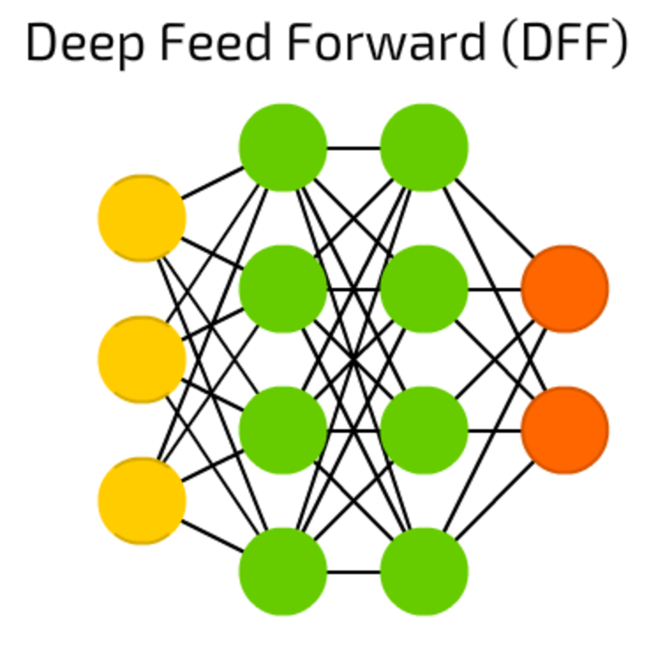
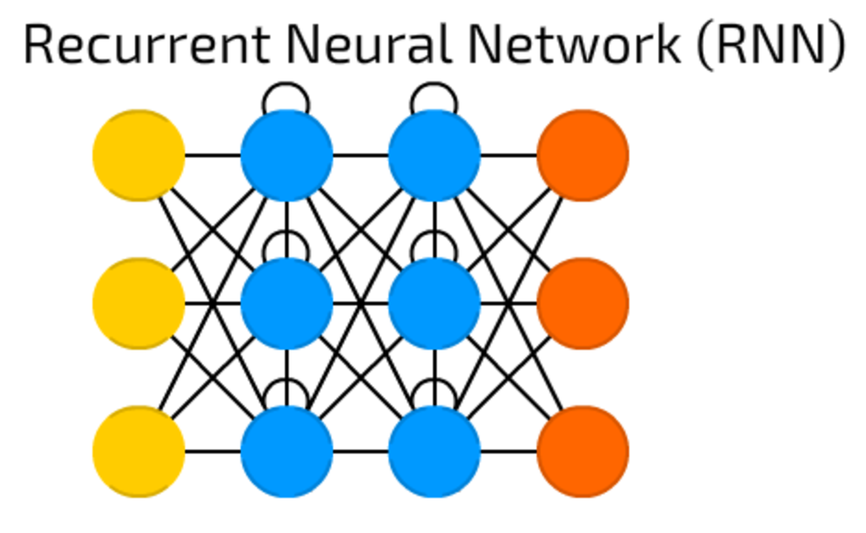
RBF neural networks are actually FF (feed forward) NNs, that use radial basis function as activation function instead of logistic function.
These are just FF NNs, but with more than one hidden layer. When training a traditional FF, we pass only a small amount of error to previous layer. Because of that stacking more layers led to exponential growth of training times, making DFFs quite impractical.
Recurrent Neural Networks introduce different type of cells — Recurrent cells. The first network of this type was so called Jordan network, when each of hidden cell received it’s own output with fixed delay — one or more iterations. Apart from that, it was like common FNN.
This type of NNs is mainly used then context is important — when decisions from past iterations or samples can influence current ones. The most common examples of such contexts are texts — a word can be analysed only in context of previous words or sentences.

Slide 11
Design steps of NN
Architecture
(Topology)
Neurons
Layers
Patterns
Outputs
Patterns
Training + validation
Training Algorithm
Training Phase
Validation Phase

Slide 12


Advantages / Disadvantages
Storing information on the entire network
Ability to work with incomplete knowledge
Having fault tolerance
Having a distributed memory
Gradual corruption
Ability to make machine learning
Parallel processing capability
Hardware dependence
Unexplained behavior of the network
Determination of proper network structure
Difficulty of showing the problem to the network
The duration of the network is unknown

Slide 13
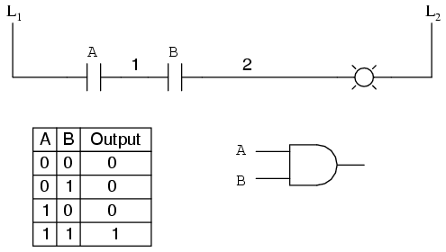
AND function example

Slide 14
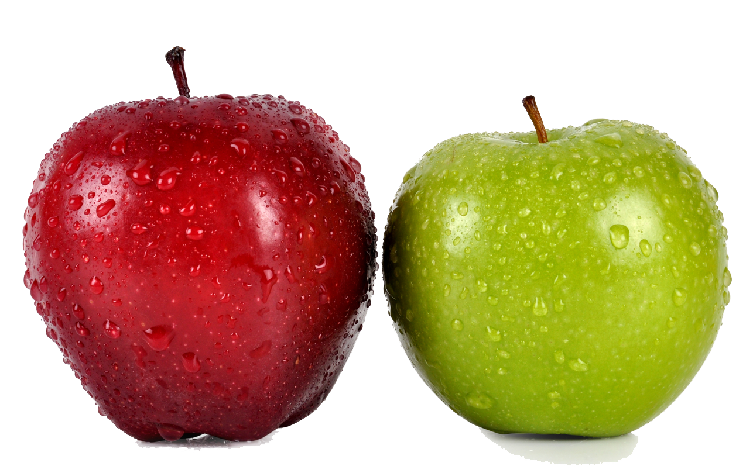
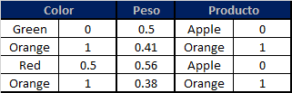
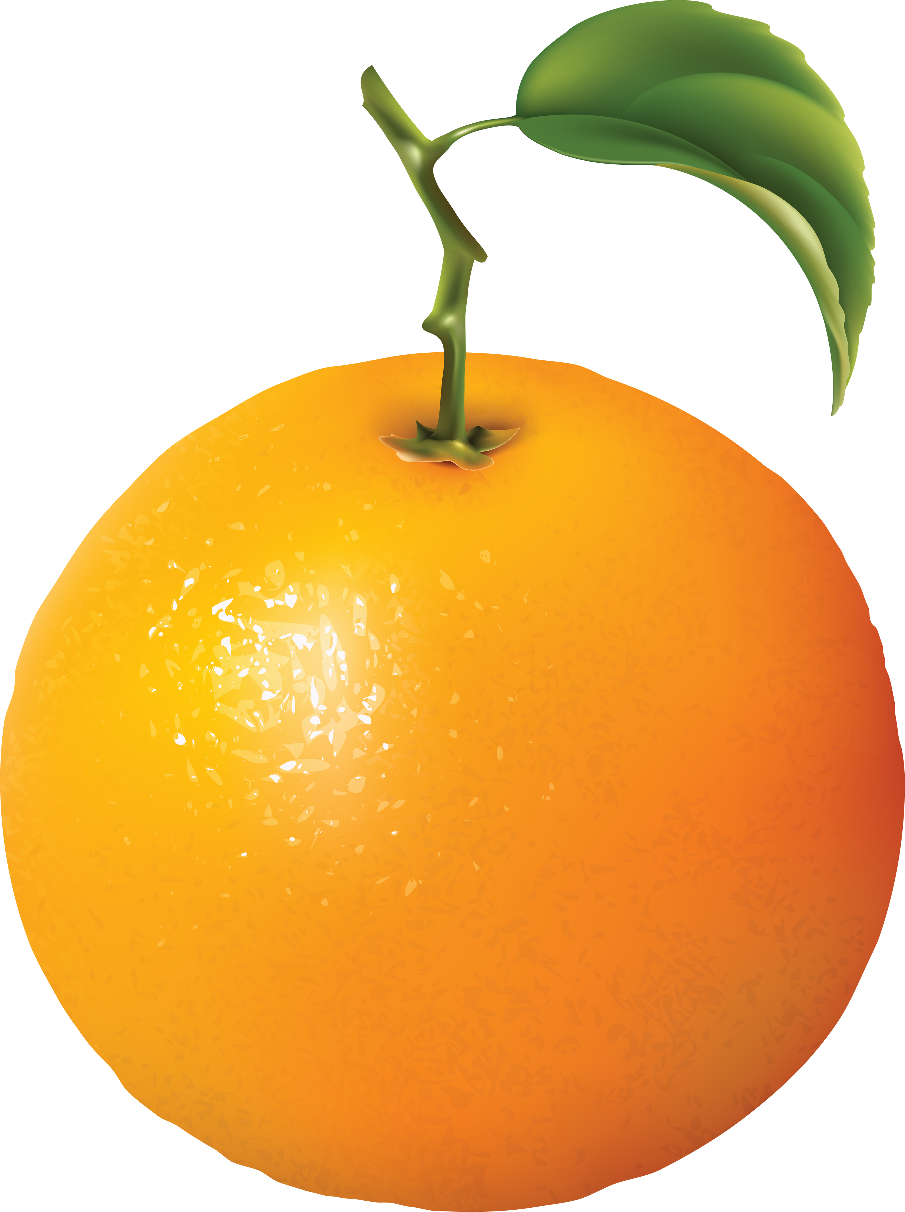
Example

Slide 15
Backpropagation

Slide 16
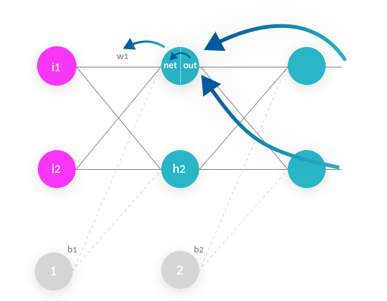
Back propagation algorithm
Backpropagation: A neural network learning algorithm
Started by psychologists and neurobiologists to develop and test computational analogues of neurons
A neural network: A set of connected input/output units where each connection has a weight associated with it
During the learning phase, the network learns by adjusting the weights so as to be able to predict the correct class label of the input tuples
Also referred to as connectionist learning due to the connections between units

Slide 17
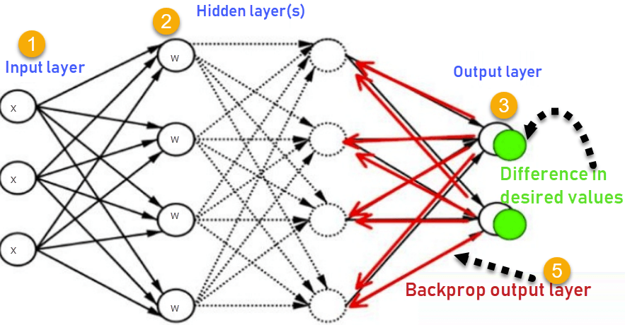
Contd..
Iteratively process a set of training tuples & compare the network's prediction with the actual known target value
For each training tuple, the weights are modified to minimize the mean squared error between the network's prediction and the actual target value
Modifications are made in the “backwards” direction: from the output layer, through each hidden layer down to the first hidden layer, hence “backpropagation”
Steps
Initialize weights (to small random #s) and biases in the network
Propagate the inputs forward (by applying activation function)
Backpropagate the error (by updating weights and biases)
Terminating condition (when error is very small, etc.)

Slide 18
Contd..
Efficiency of backpropagation: Each epoch (one interation through the training set) takes O(|D| * w), with |D| tuples and w weights, but # of epochs can be exponential to n, the number of inputs, in the worst case
Rule extraction from networks: network pruning
Simplify the network structure by removing weighted links that have the least effect on the trained network
Then perform link, unit, or activation value clustering
The set of input and activation values are studied to derive rules describing the relationship between the input and hidden unit layers
Sensitivity analysis: assess the impact that a given input variable has on a network output. The knowledge gained from this analysis can be represented in rules

Slide 19
Two phases: propagation and weight update.
Phase 1: Propagation
Each propagation involves the following steps:
Forward propagation of a training pattern's input through the neural network in order to generate the propagation's output activations.
Back propagation of the propagation's output activations through the neural network using the training pattern's target in order to generate the deltas of all output and hidden neurons.

Slide 20
Contd..
Phase 2: Weight update
For each weight-synapse:
Multiply its output delta and input activation to get the gradient of the weight.
Bring the weight in the opposite direction of the gradient by subtracting a ratio of it from the weight.
Repeat the phase 1 and 2 until the performance of the network is good enough.
This ratio influences the speed and quality of learning; it is called the learning rate. The sign of the gradient of a weight indicates where the error is increasing, this is why the weight must be updated in the opposite direction.

Slide 21
P/C
Weakness
Long training time
Require a number of parameters typically best determined empirically, e.g., the network topology or ``structure."
Poor interpretability: Difficult to interpret the symbolic meaning behind the learned weights and of ``hidden units" in the network
Strength
High tolerance to noisy data
Ability to classify untrained patterns
Well-suited for continuous-valued inputs and outputs
Successful on a wide array of real-world data
Algorithms are inherently parallel
Techniques have recently been developed for the extraction of rules from trained neural networks

Slide 22
CONVOLUTIONAL NEURAL NETWORKS

Slide 23

Introduction
A Convolutional Neural Network (ConvNet/CNN) is a Deep Learning algorithm which can take in an input image, assign importance (learnable weights and biases) to various aspects/objects in the image and be able to differentiate one from the other. The pre-processing required in a ConvNet is much lower as compared to other classification algorithms. While in primitive methods filters are hand-engineered, with enough training, ConvNets have the ability to learn these filters/characteristics.
The architecture of a ConvNet is analogous to that of the connectivity pattern of Neurons in the Human Brain and was inspired by the organization of the Visual Cortex. Individual neurons respond to stimuli only in a restricted region of the visual field known as the Receptive Field. A collection of such fields overlap to cover the entire visual area

Slide 24

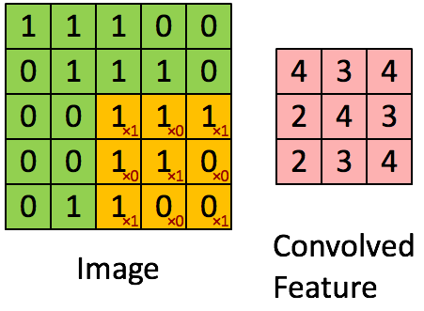
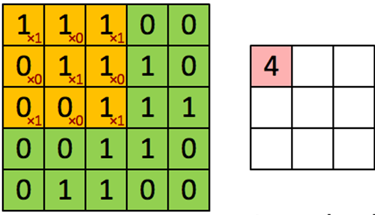
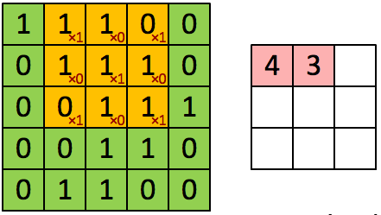
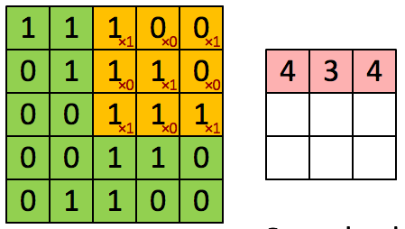
Terminology
Pooling
Reduce the dimensions of the data by combining the outputs of neuron clusters at one layer into a single neuron in the next layer.
Convolution
Is a mathematical operation on two functions (f and g) that produces a third function expressing how the shape of one is modified by the other. The term convolution refers to both the result function and to the process of computing it

Slide 25

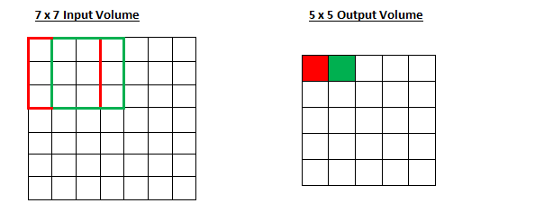
Padding and Stride
Stride is a parameter of the neural network's filter that modifies the amount of movement over the image or video.
If the filter size is 3x3 pixels, the contained nine pixels will be converted down to 1 pixel in the output layer. Naturally, as the stride, or movement, is increased, the resulting output will be smaller. Stride is a parameter that works in conjunction with padding, the feature that adds blank, or empty pixels to the frame of the image to allow for a minimized reduction of size in the output layer.
Roughly, it is a way of increasing the size of an image, to counteract the fact that stride reduces the size. Padding and stride are the foundational parameters of any convolutional neural network.

Slide 26
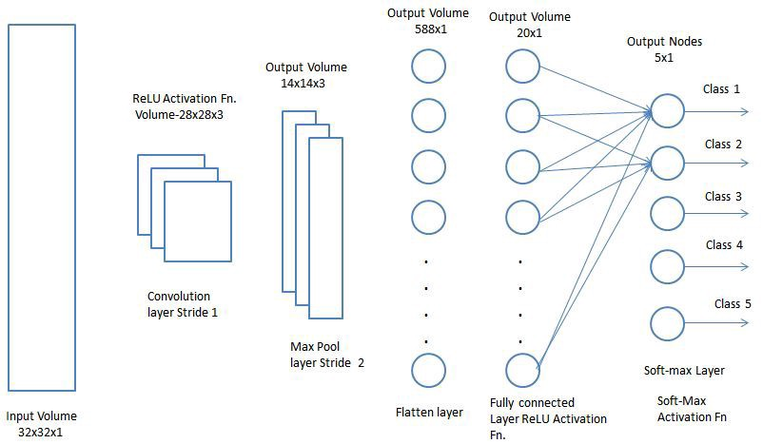
Classification — Fully Connected Layer (FC Layer)

